Slide 1
Mixed-Modal Curriculum Design
spam.digisim.uk
digisim

Slide 2
A ‘prompted discussion’ in three parts.
20
Part 1 – Back to the Future. mins
30
Part 2 – Conscious Modality. mins
30
Part 3 – The Considered Curriculum. mins
10
Part 4 – Summary & Close. mins

Slide 3
Crowd Sourced Notes / Thoughts / Questions
Set up a Padlet (or equivalent) for participants to add notes / thoughts or questions throughout the session).
Place the Padlet QR code here.
Throughout the session please feel free to add:
Comments about the themes/topics we discuss.
Questions related to the session or the wider implications for your own work.
Links to other resources and information to help inform discussions.
Responses to tasks and discussions.
Anything else you think is useful / relevant to the conversation and/or longer term strategic approach.
Can be useful to indicate whether it is: Comment / Question / Resource etc
Paset Padlet URL Here ………………………………

Slide 4
Part 1 Back to the Future.
20
mins (ish).

Slide 5
We’ve all been on a journey.
3
We are all on our own paths, all on our own journeys. Sometimes the paths cross, and people arrive at the crossing points at the same time and meet each other.
Thomas Hardy – Far From the Madding Crowd

Slide 6
Paths cross at fleeting junctures,
Life's journey a tapestry of intersecting clusters.
Where roads meet, paths entwine,
Different paths, but arriving at the same place in line.
Generated by Artificial Intelligence - Chat GPT

Slide 7
Paths cross at fleeting junctures,
Life's journey a tapestry of intersecting clusters.
Where roads meet, paths entwine,
Different paths, but arriving at the same place in line.
Generated by Artificial Intelligence - Chat GPT
Input 1: A short one verse poem about people on journeys and paths that cross.
Input 2: Amend the last line to something about arriving at the same place.

Slide 8
What does the regulator want?
https://www.officeforstudents.org.uk/news-blog-and-events/press-and-media/ofs-responds-to-blended-learning-review/

Slide 9
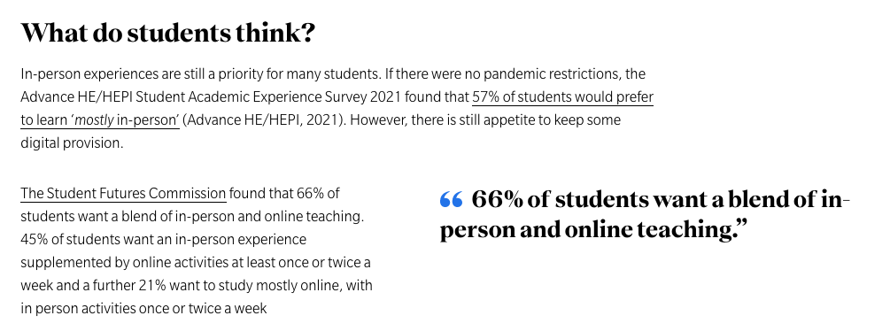
What do students want?
https://www.universitiesuk.ac.uk/what-we-do/policy-and-research/publications/lessons-pandemic-making-most

Slide 10
What do students want?
https://www.jisc.ac.uk/blog/students-want-blended-learning-but-we-still-have-a-long-way-to-go-21-sep-2022

Slide 11
But………………..
https://wonkhe.com/blogs/have-students-learned-to-love-blended-provision/

Slide 12
But………………..
https://www.bbc.co.uk/news/education-64130367

Slide 13
However………………..
https://wonkhe.com/blogs/have-students-learned-to-love-blended-provision/

Slide 14
Including staff?
“There is a clear desire to move to blended learning making use of pre-recorded lectures and suitable technologies to interact and engage students in addition to active learning in face-to-face teaching. Flipped learning, a method students respond well to, was commonly referred to as an area of future travel.”
Robson, L. Gardner, B. and Dommett, E.J. (2022)
The post-pandemic lecture : views from academic staff across the UK. Education Sciences, 12 (2). 123.
https://doi.org/10.3390/educsci12020123

Slide 15
Including staff?
“……….a bigger question remains about how the pandemic has changed future of education. While many aspects will evolve, one important change is that the nature of education and learning will become hybrid by default.”
Soumitra Dutta - Professor of Management at Cornell University
https://gbsn.org/hybrid-by-default-the-future-of-education-has-changed/

Slide 16
And global organisations?
https://unesdoc.unesco.org/ark:/48223/pf0000373767?posInSet=3%26queryId=b40003f4-2249-4974-84e4-acb9bc32fcf9

Slide 17
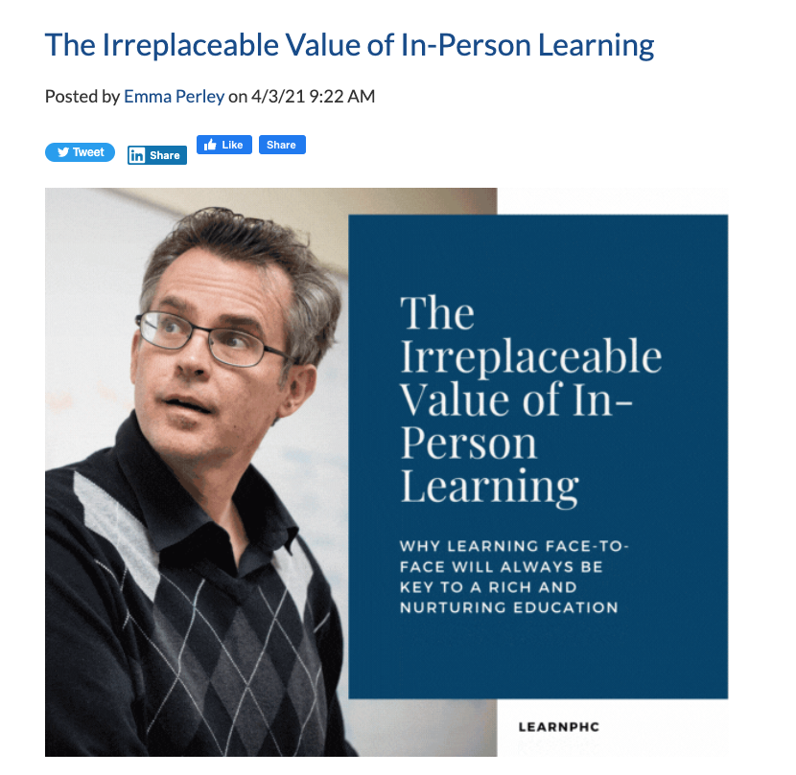
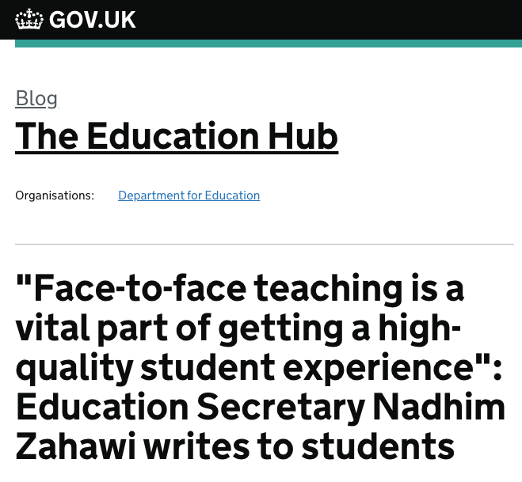
All with a note of caution…….
https://www.phc.edu/learnphc/inpersonlearning
https://educationhub.blog.gov.uk/2022/01/17/face-to-face-teaching-is-a-vital-part-of-getting-a-high-quality-student-experience-education-secretary-nadhim-zahawi-writes-to-students/

Slide 18
Setting Expectations!
Less
‘Pick n Mix’
More
‘A La Carte’

Slide 19
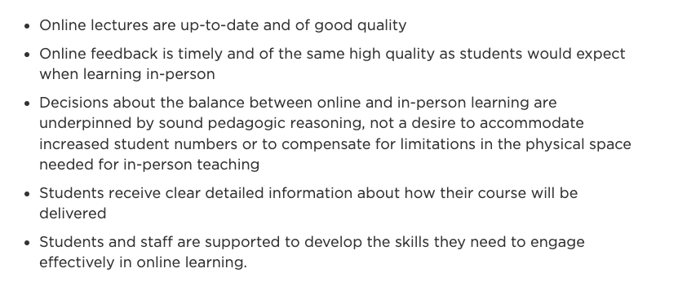
OfS - Compliance
https://www.officeforstudents.org.uk/news-blog-and-events/press-and-media/ofs-responds-to-blended-learning-review/

Slide 20
Hyflex? – Yes, but in reality not yet!
https://sussexstudent.com/news/article/hybrid-learning-uni-response

Slide 21
Hyflex? – Your own experiences?
Sharing experiences of Hyflex:
Benefits for students?
Challenges for students?
Benefits for Staff?
Challenges for Staff?

Slide 22
Crowd Sourced Notes / Thoughts / Questions
Set up a Padlet (or equivalent) for participants to add notes / thoughts or questions throughout the session).
Place the Padlet QR code here.
Use the Padlet to share experiences of using Hyflex / Dual Delivery
Paset Padlet URL Here ………………………………

Slide 23
Hyflex? – Your own experiences?
Sharing experiences of Hyflex:
Benefits for students?
Challenges for students?
Benefits for Staff?
Challenges for Staff?
Yay / Nay / On the Fence

Slide 24
Part 2 Conscious Modality
30
mins (ish).

Slide 25
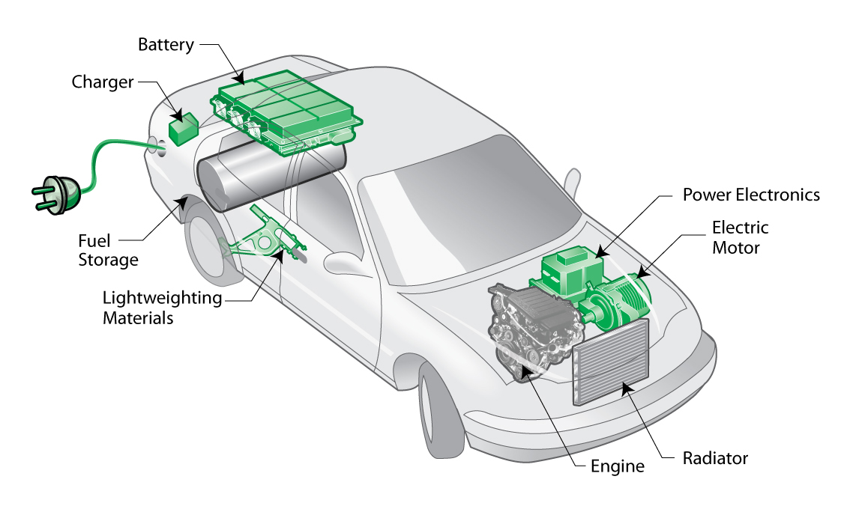
But first………………terminology.
https://spam.digisim.uk/generic/hybrid-defining-in-the-context-of-spam/

Slide 26
TASK
What terminology are you using for a mixture of on campus & online facilitated learning?
Is there a shared understanding of what this means?
Each table discuss and post a term and description in the Padlet. (If a table beats you to it feel free to comment on their response or give it a thumbs up if you agree or thumbs down if you don’t).
Notes:
Discuss benefits of an agreed set of terminology. Make sure that terminology is clear and that there is a clear definition for use in the organisation that everyone can refer to.

Slide 27
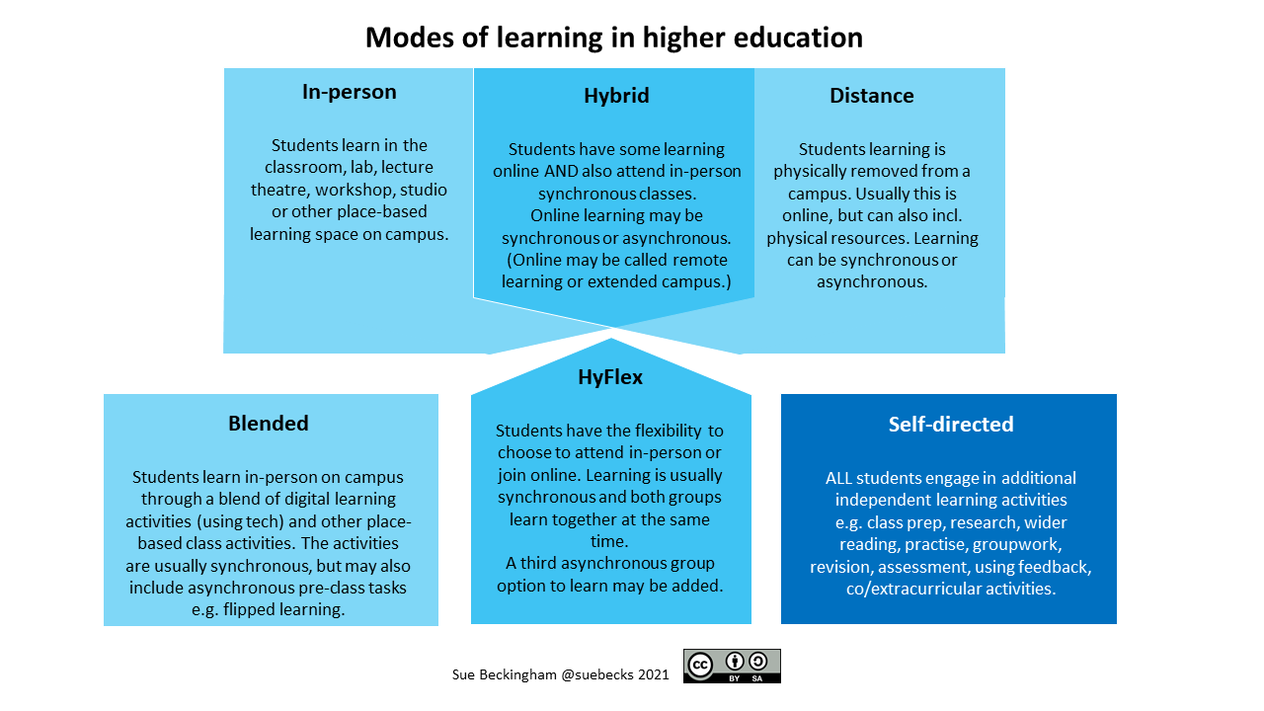
A frame of reference.

Slide 28
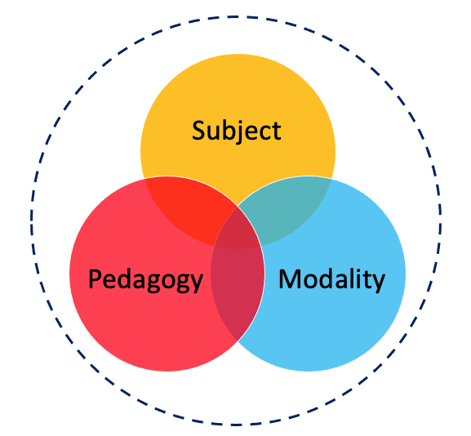
Technology to Modality
Reproduced by permission of the publisher, © 2012 by tpack.org
SPaM Framework © 2022 by Simon Thomson is licensed under CC BY 4.0

Slide 29
SPaM – A Framework for Hybrid Education
Three core knowledge domains
Interlinked – influence each other
A point of reference for:
Curriculum Design
Expertise and Knowledge
Guidance and Support
Policy and Processes
Evaluation and Review
Digital Infrastructure Needs
SPaM Framework © 2022 by Simon Thomson is licensed under CC BY 4.0

Slide 30
SPaM – A Framework for Hybrid Education
Subject
Pedagogy
Modality
What is it that we will teach and that students will learn?
How will we teach this subject and how will we assess the learners?
How will learners access this learning and what modes work best for different activities?
SPaM Framework © 2022 by Simon Thomson is licensed under CC BY 4.0

Slide 31
Modes of Teaching
In Person
Online
On Campus
Synchronous
In Person
Online
Off Campus
Asynchronous

Slide 32
Considerations of Modality
What can/can’t be taught through certain modes?
How accessible are particular modes of learning?
To what extent can certain modes support student participation, engagement and active learning?
To what extent can certain modes support cohort cohesion and student well-being?
Which modes work best for certain activities?
What else might we consider? (10 minute discussion)

Slide 33
Crowd Sourced Notes / Thoughts / Questions
Set up a Padlet (or equivalent) for participants to add notes / thoughts or questions throughout the session).
Place the Padlet QR code here.
Reminder to use the Padlet to share responses to the questions posed on the previous slide.
Paset Padlet URL Here ………………………………

Slide 34
Part 3 The Considered Curriculum.
30
mins (ish).

Slide 35
A ‘considered curriculum’ is one which has taken into account all aspects of its design & facilitation and the impact on the learning and teaching experience.
(A working definition)

Slide 36
Crowd Sourced Notes / Thoughts / Questions
Set up a Padlet (or equivalent) for participants to add notes / thoughts or questions throughout the session).
Place the Padlet QR code here.
Reminder to use the Padlet to share responses to the questions posed on the next few slides.
Paset Padlet URL Here ………………………………

Slide 37
TASK! – In person / On Campus or Off Campus
What in person, on campus teaching activities are critical to students (achieving their learning)?

Slide 38
TASK! – In person / On Campus or Off Campus
What in person, on campus teaching activities are beneficial to students (achieving their learning)?

Slide 39
TASK! – Online Synchronous
What teaching and learning activities are best suited to online synchronous activity?

Slide 40
TASK! – Online Asynchronous
What teaching and learning activities are best suited to online asynchronous activity?

Slide 41
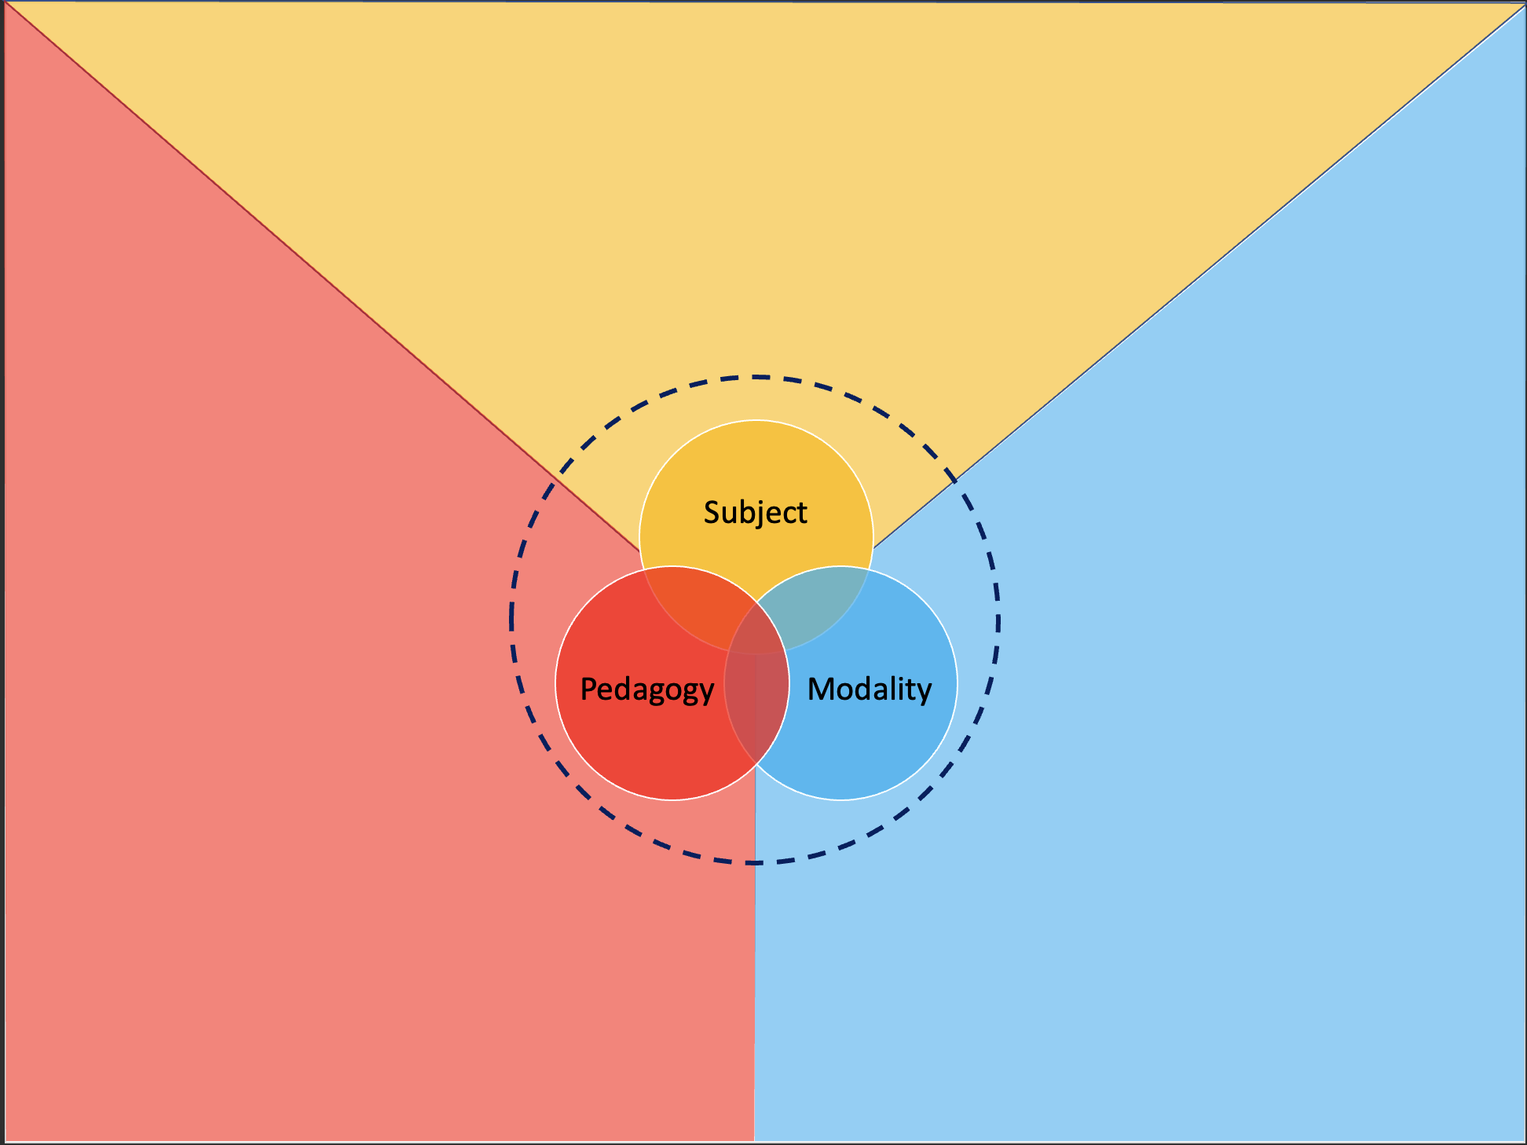
In Practice – design a mixed modal topic.
15
mins
Introduction to research methods.
Must use at least two modes to teach this topic.
Must include a formative assessment task.

Slide 42
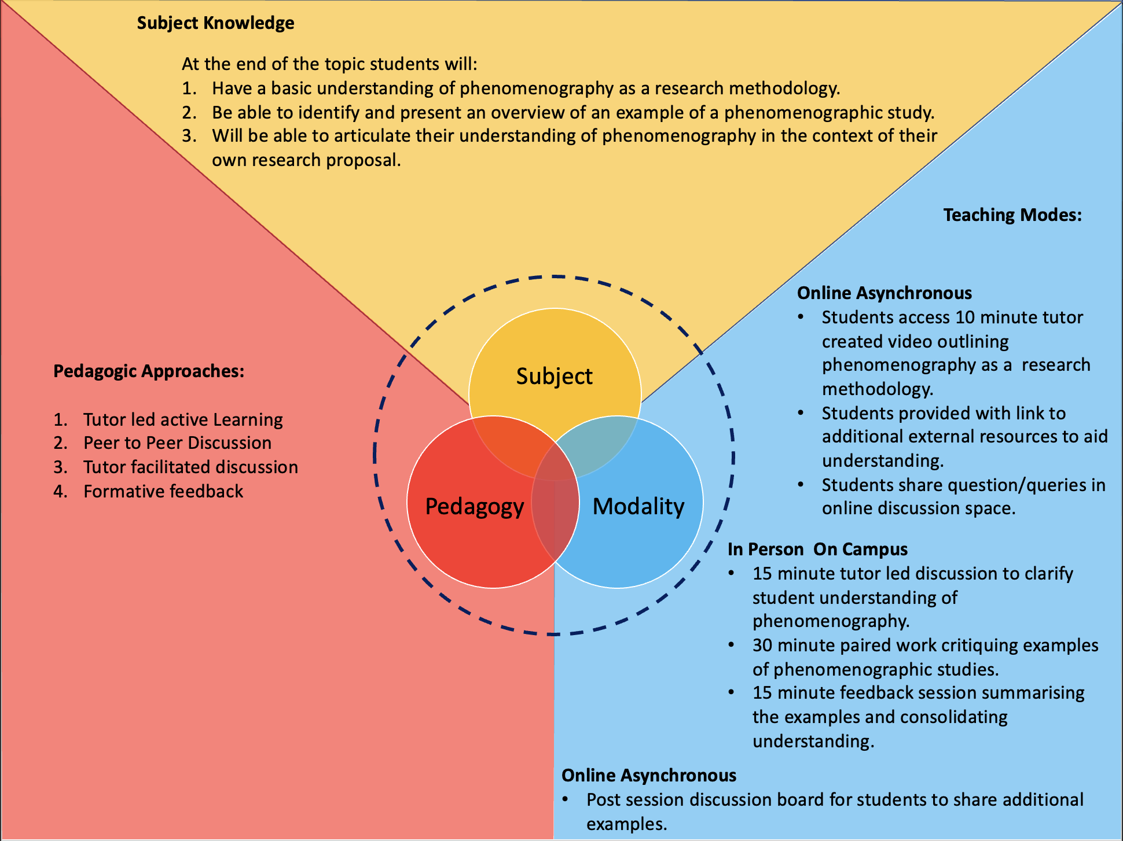
An Example

Slide 43
Plan for product launch
Week | Subject (Topic) | Pedagogy (Teaching Activity) | Modality (Teaching Mode)
1 | General intro to research methods | 15 min introductory video resource (tutor created) Online tutor led discussion session | Online Asynchronous Online Synchronous
2 | Qualitative vs Quantitative | Pre session questions submitted by students Guest Lecture (internal) Seminar session critiquing short papers. | Online Asynchronous In Person On Campus In Person On Campus
3 | Grounded theory | Guest lecture (external) Grounded theory practical exercise | Online synchronous In Person On Campus
4 | Ethnography | Ethnography Field Trip and exercise | In Person Off Campus
5 | Descriptive Quantitative Research | Guest lecture (external) Practical exercise | In Person On Campus Online Asynchronous
6 | Correlational Quantitative Research | Guest lecture (external) Practical exercise | In Person On Campus Online Asynchronous
7 | Mixed methods | External video resource and exercise. Case study critiques | Online Asynchronous In Person On Campus
Notes:
Weekly module plan showing multi-modal planning

Slide 44
Other Examples
Exploring the potential for some in person off campus activity to be offered to students in an online synchronous also.
Chemistry
Developed instructional videos for basic lab instruction to free up lab time for more in person access to carry out actual lab tasks.
Psychology
Used to be heavily lecture based with poor attendance after a few weeks. Moved to a bookend lecture model (weeks 1&2 and 11&12) with online sync lectures in between.
History
Increased used of online synchronous as part of a guest lecture programme (In support of decolonising the curriculum activity) seeking a broader range of voices from the global majority within the subject.
Series of short pre-recorded videos to replace some lectures. The hour not being used for the lecture is now used for a live synchronous online Q&A discussion session.
Geography
Computer Science
Notes:
Examples of the benefits of bringing discussions of “modality” into curriculum design discussions.

Slide 45
Summary & Close
Modality should be a key consideration in curriculum design discussions and planning.
Modality should both inform and be informed by Subject requirements and Pedagogic approaches.
Make use of all your ‘experts’ to seek advice and guidance in areas where you might lack experience or knowledge.
Work with students to inform decisions and to agree rationale(s) for using particular modes.
Ensure that the balance of modes is clearly communicated to students.

Slide 46
Thank you
Thomson, S. (2022). SPaM – A Framework to support the Development of Hybrid Education. SPaM Framework. https://spam.digisim.uk

